Slide 1
Predicting Purchasing Intent from User Behaviour on e-Commerce Platform
Zaki Hamzah Lee – Data Consultant

Slide 2
Agenda
Industry Context
The Problem
The Data
Feature Engineering & Selection
Key Performance Indicators
Model Training & Validation
Marketing Strategy

Slide 3

USD 4.2 trillion
2021 projected online sales
The Industry
50% digital
2020-2025 global retail growth
22 billion
June 2020 retail website visits
2.19%
2020 shopper conversion rate
Source: Forbes, Statista

Slide 4


What?
Ratio of purchases to visits, expressed as a percentage
2.19%
2020 shopper conversion rate
So what?
418 million visits across 6 SEA nations in 2020
0.1% conversion rate increase – USD $13.38 million
Who cares?
They do, so we have to
Their 0.1%, our whole business - everyone is a stakeholder
Source: Economic Development Board Singapore, iPrice, SimilarWeb, AppsFlyer

Slide 5
The Problem
Visit ≠ Purchasing intent
Just browsing (Low intent)
Purchasing intent ≠ Purchase
Cheaper competitor (High intent, but alternative cheaper)
High checkout fees (High intent, but final price increased)
User feelings unknown, but user activity known
Business question: Can we identify users with purchasing intent from their user session activity to apply targeted marketing strategies and increase purchases?
Data question: What features and model best predict user purchasing intent from user session data?

Slide 6
The Data
Oct 2020 event activity for Electronics e-Commerce store in Singapore (assumed)
161,544 records, 9 variables
Event Types: view, cart, purchase
“User Session” can be open for days – unreliable
Daily user activity used as visits
92,277 visits – 3,983 purchases; 88,294 no purchases
Event Time | Event Type | Product ID | Category ID | Category Code | Brand | Price | User ID | User Session
2020-10-01 00:33:34+00:00 | purchase | 1168166 | 2144415927049912542 | electronics.video.tv | starwind | 105.87 | 1515915625521281104 | SJUH0TBLGD

Slide 7
Workflow
Feature Engineering
Train-Test Cross Validation & Hyperparameter Tuning
Model Validation on Validation Dataset
1
3
5
2
4
6
80-20 Train-Test Validation Split
KPI Comparison & Model Selection
Final Performance Evalulation
Notes:
Why not rebalance the dataset?
First round of modelling and hyperparameter tuning without rebalancing was able to attain highest possible reasonable recall – since the model worked on validation data, no further assumptions/rebalancing needed.
Several assumptions made in feature engineering – better to avoid more assumption/synthetic data to better estimate algorithm performance on real validation data. Occam’s Razor.
Assumptions during feature engineering:
Daily user activity used as proxy for continuous, distinct user session no matter what time first and last transaction are
Assume that most frequently browsed category ID is the item that is purchased. Reason is that if we introduce a variable for whether the most frequently browsed product is the item purchased, the value for non-purchases will always be undefined/null.

Slide 8
Feature Engineering & Selection
Current Visit Activity
Most Recent Visit Activity
Historical Visit Activity
Most Recent and Historical Visit Activity metrics biased against new users
Feature engineering limited to Current Visit Activity
Past Visit Activity useful for other applications e.g. customer profiling, rewards program

Slide 9
Feature Engineering & Selection
Feature engineering based on inferred interest
Time investment
Repeated product engagement (‘view’ and ‘cart’)
Pre-purchase action (‘cart’)
Event Time | Event Type | Product ID | Category ID | Category Code | Brand | Price | User ID | User Session
2020-10-01 00:33:34+00:00 | purchase | 1168166 | 2144415927049912542 | electronics.video.tv | starwind | 105.87 | 1515915625521281104 | SJUH0TBLGD
Daily User Session (Index) | Duration in Seconds | Count of ‘Views’ and ‘Carts’ for most frequently browsed Category ID | Cart Quantity | Purchased (Target) | Purchase Value | Cart Value
1515915625521281104 _2020-10-01 | 1560 | 4 | 1 | 1 | 105.87 | 105.87

Slide 10
Key Performance Indicators
High Recall score – Accurate prediction of purchasing intent
Model training time
Note: False Positives not model failure
Predicted purchasing intent, but outcome was no purchase
Remember: Purchasing intent ≠ Purchase
Essential target group for marketing strategy

Slide 11
Train-Test Results
Algorithm | Mean Train-Test Recall | Mean Model Train Time (seconds)
Logistic Regression | 28.2% | 0.332
Support Vector Machine | 33.5% | 47.8
Naïve Bayes | 60.2% | 0.0195
Decision Tree | 60.9% | 0.0419
Random Forest | 65.5% | 1.91
AdaBoost | 80.7% | 0.965
XGBoost | 89.2% | 1.60
XGBoost (tuned) | 92.9%
All models had practical training time
XGBoost highest in Recall score
Hyperparameter tuning boosted Recall score to 92.9% → Selected for validation

Slide 12
Predicted Outcome
Validation
 | No Purchase | Purchase
No Purchase | 17,280 (TN) | 379 (FP)
Purchase | 56 (FN) | 741 (TP)
Recall score: 93.0%
Highly accurate purchasing intent prediction
All 56 FN were purchases without ‘cart’ event
Feature Importance (normalized):
Cart Quantity (0.895)
Count of ‘Views’ and ‘Carts’ for most frequently browsed Category ID (0.104)
Duration in Seconds (0.001)
Actual Outcome

Slide 13
Marketing Strategy
Predicted Outcome
 | No Purchase | Purchase
No Purchase | 0.01% Cart Quantity >0 | 100% Cart Quantity >0
Purchase | 0% Cart Quantity >0 | 100% Cart Quantity >0
Adding items to cart key indicator of purchasing intent
Focus strategy on top causes of cart abandonment:
Just browsing/Not ready to buy – 58.6%
Extra costs too high (shipping, tax, fees) – 20.3%
Actual Outcome
Source: Baymard Institute

Slide 14
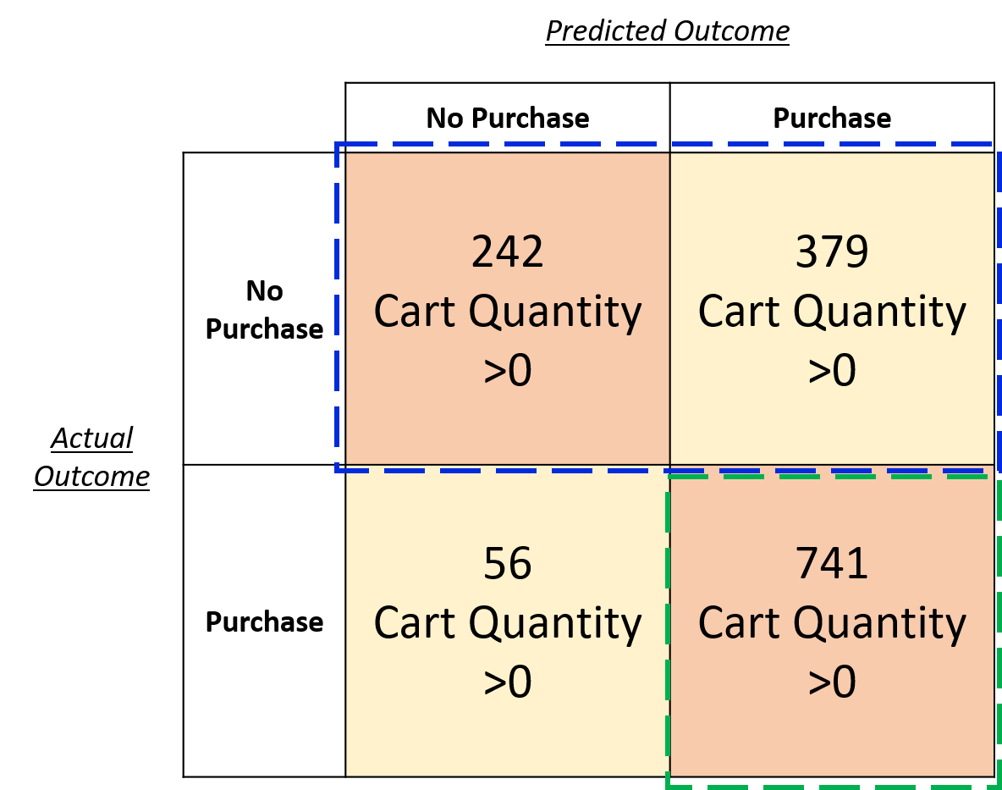
Marketing Strategy
Focus area: Cart abandonment due to
extra costs too high – 20.3%
Focus Segment
→ 20.3% * (242 + 379) = 126 additional purchases
Cost: Apply average $5 discount –
taken up by focus segment + confirmed purchases
$5 * (126 + 741) = $4,335
Average cart amount = $141
Additional revenue
→ 126 * $141 = $17,766
Assume 5% of monthly revenue for marketing budget
5% * $562,590 = $28,129
Strategy is within budget and brings more revenue than cost
0

Slide 15
Conclusion
Adding items to cart is a key indicator of purchasing intent
Tuned XGBoost model attained 93.0% recall score for predicting purchasing intent
Marketing strategies can be applied to users with predicted purchasing intent to prevent cart abandonment and increase conversion rate
Future steps
Validate marketing strategy with trial
User activity can be enriched with more variables

Slide 16
Thank You

Slide 17
Appendix
Data Source:
https://www.kaggle.com/mkechinov/ecommerce-purchase-history-from-electronics-store
Forbes:
https://www.forbes.com/sites/joanverdon/2021/04/27/global-ecommerce-sales-to-hit-42-trillion-as-online-surge-continues-adobe-reports/?sh=14404f7150fd
https://www.forbes.com/sites/michelleevans1/2021/03/25/global-e-commerce-market-to-expand-by-us1-trillion-by-2025/?sh=5f3df336cc02
Statista:
https://www.statista.com/statistics/1112595/covid-19-impact-retail-e-commerce-site-traffic-global/
https://www.statista.com/statistics/439576/online-shopper-conversion-rate-worldwide/

Slide 18
Appendix
Google Analytics:
https://support.google.com/analytics/answer/6014873?hl=en#zippy=%2Cin-this-article
Economic Development Board Singapore, iPrice, SimilarWeb, AppsFlyer:
https://www.edb.gov.sg/en/business-insights/insights/how-did-the-pandemic-affect-online-shopping-behaviour-in-2020.html
Baymard Institute:
https://baymard.com/lists/cart-abandonment-rate

